Slide 1
Analyzing Obesity data
Using R
Ashishkumar Trada (N01580242)
Dhruv Patel(N01578896)

Slide 2
Introduction:
Obesity, which causes physical and mental problems, is a global health problem with serious consequences. The prevalence of obesity is increasing steadily, and therefore, new research is needed that examines the influencing factors of obesity and how to predict the occurrence of the condition according to these factors. Dataset Information
This dataset include data for the estimation of obesity levels in individuals from the countries of Mexico, Peru and Colombia, based on their eating habits and physical condition.
The data contains 17 attributes and 2111 records, the records are labeled with the class variable Obesity Level
https://www.kaggle.com/datasets/fatemehmehrparvar/obesity-levels

Slide 3
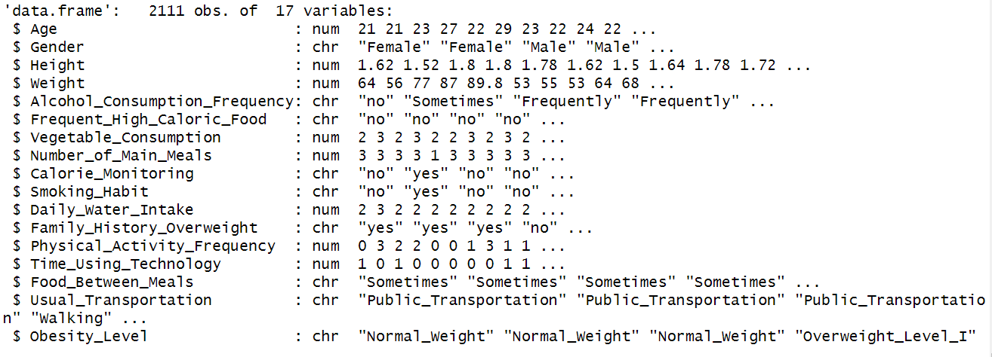

Slide 4
Language and Library which are used:
R
DPLYR
GGPLOT2

Slide 5
Data Creation Process

Slide 6
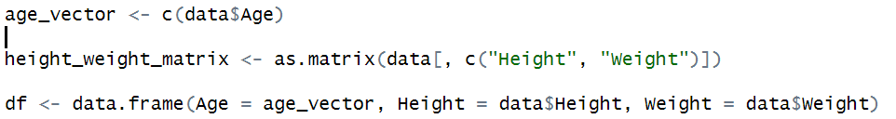
Create a vector on age column
Create a height weight matrix
Create a dataframe with vector and matrix

Slide 7


Factors on Gender
Factors on Obesity Levels

Slide 8
Data Manipulation using DPLYR Library

Slide 9




Selecting Data: Selects specific columns (Age, Gender, Height,Weight, Obesity_Level) from the dataset
Arrange Data: Arrange the data by age
Mutate table: add BMI column based on height and weight
Filter data based on obesity levels

Slide 10


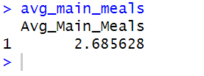
Calculating average Age and BMI for obese individuals
Calculate the average number of main meals per day

Slide 11
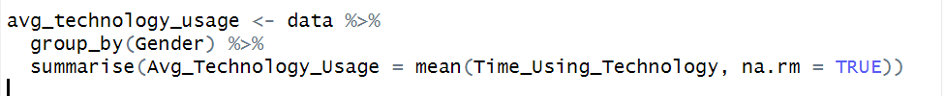
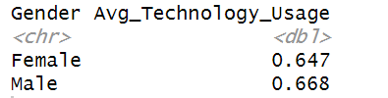

AVG technology usage by gender
Percentage of high caloric food in data

Slide 12
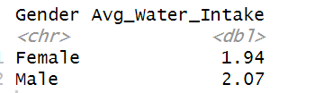
AVG water intake by gender

Slide 13
Graphical Representation

Slide 14
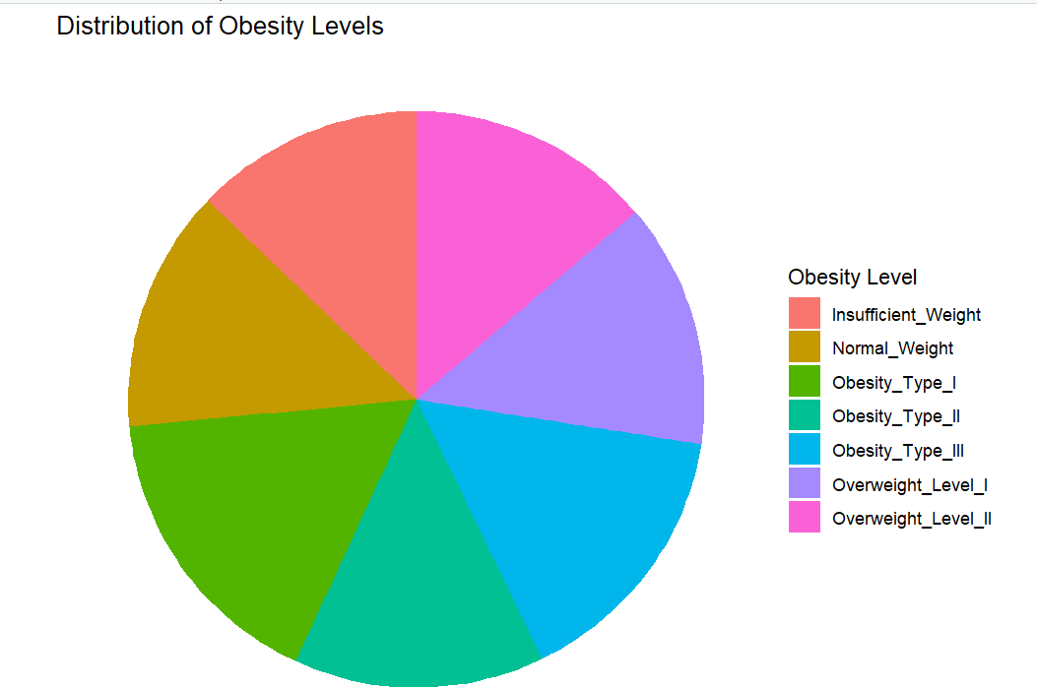
Obesity Level distribution in dataset

Slide 15
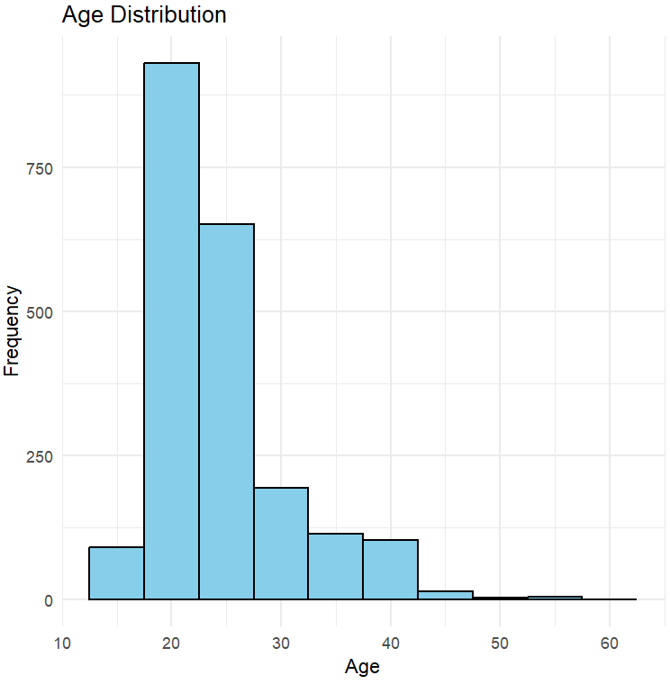
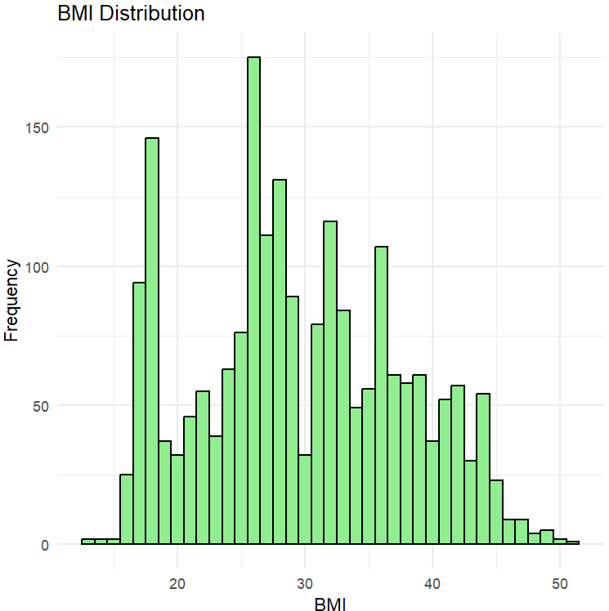
Age Distribution
BMI Distribution

Slide 16
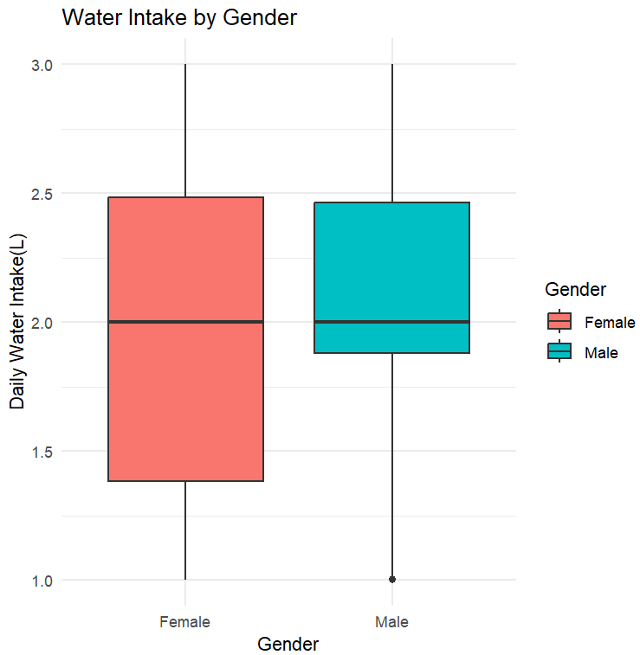
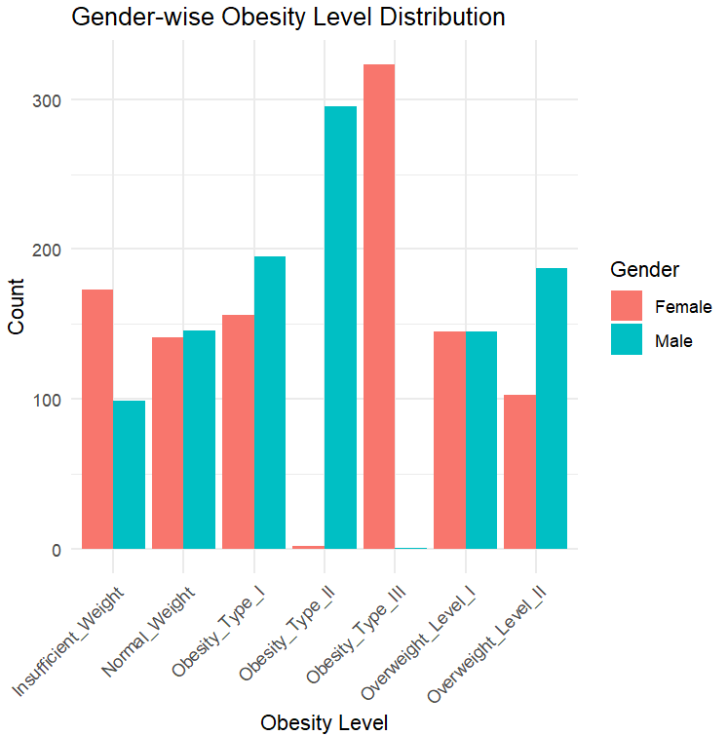
Females exhibit a higher prevalence of underweight compared to males.
A significant proportion of females have Obesity Type II.
Conversely, a notable number of males suffer from Obesity Type III.
Males tend to be overweight compared to females.
Daily water intake is more in male than female
Female consumes 1.5L to 2.5L of water daily
Male consumes 1.80L to 2.5L of water daily

Slide 17
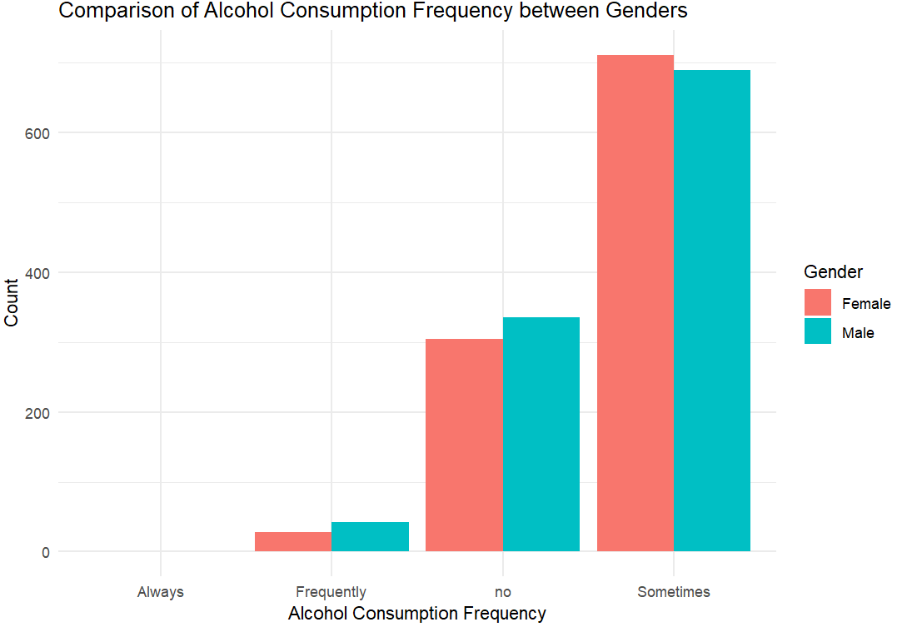
Alcohol consumption
The majority of individuals in the dataset are not heavy drinkers; they consume alcohol occasionally or infrequently.

Slide 18
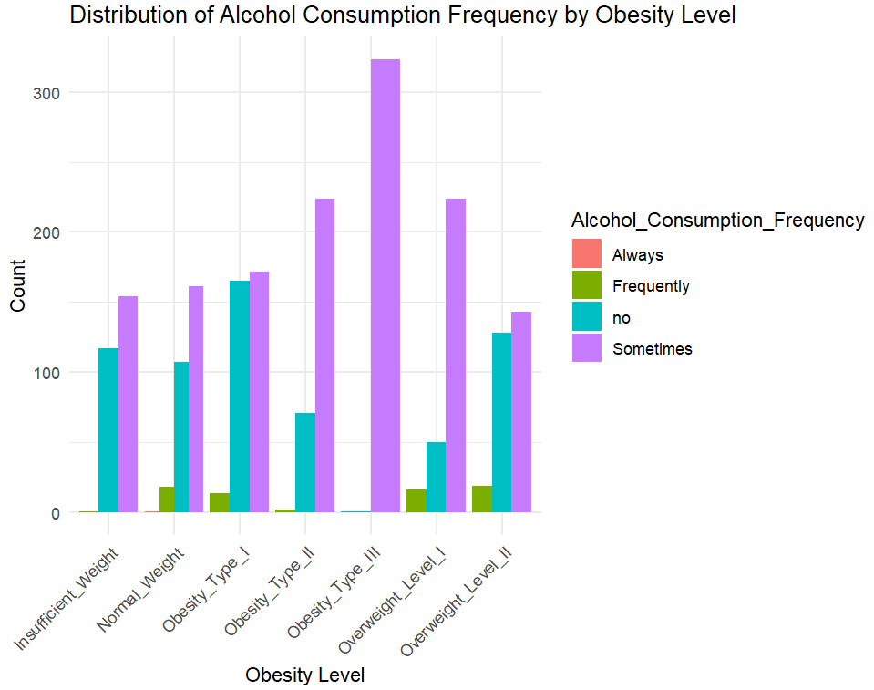
Alcohol Consumption and Obesity:
People who do not consume alcohol tend to have lower obesity levels, with a majority of them being categorized as Obesity Type II.
Those who consume alcohol occasionally, which represents a significant portion of the dataset, are more likely to have Obesity Type I.
Individuals who drink alcohol frequently are more prone to being categorized as Overweight Level II.

Slide 19
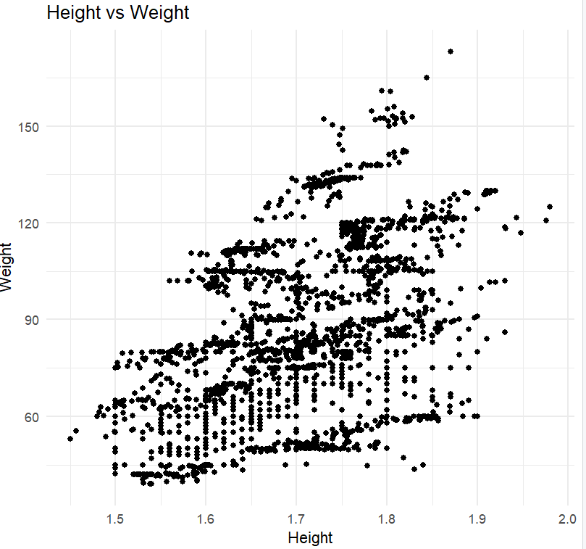
Height vs. Weight:
As height increases, weight also increases.

Slide 20
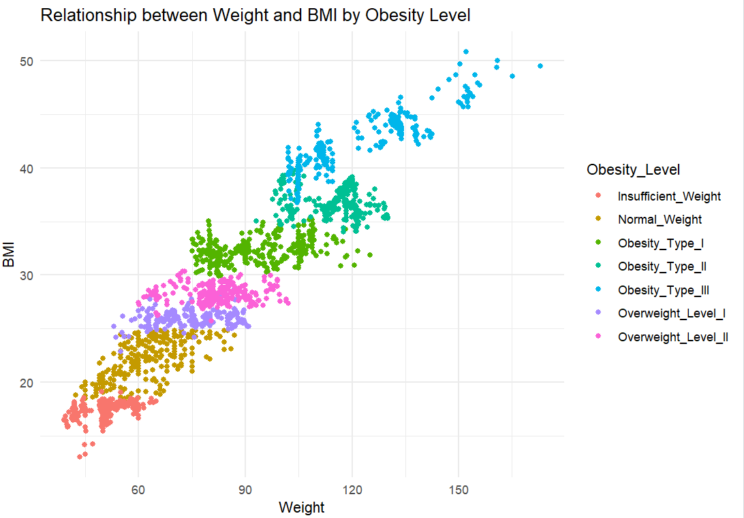
Weight and BMI Relationship:
There's a clear relationship between weight and BMI.
Individuals with a BMI under 20 are classified as having insufficient weight.
Those with a BMI between 20 and 25 fall into the normal weight category.
BMI values ranging from 25 to 27.5 indicate Obesity Type I.
Obesity Type II is identified in individuals with a BMI between 28 and 30.
BMI values between 30 and 35 signify Obesity Type III.
Individuals with a BMI between 35 and 40 are classified as having Overweight Level I.
Overweight Level II is assigned to those with a BMI above 40.

Slide 21
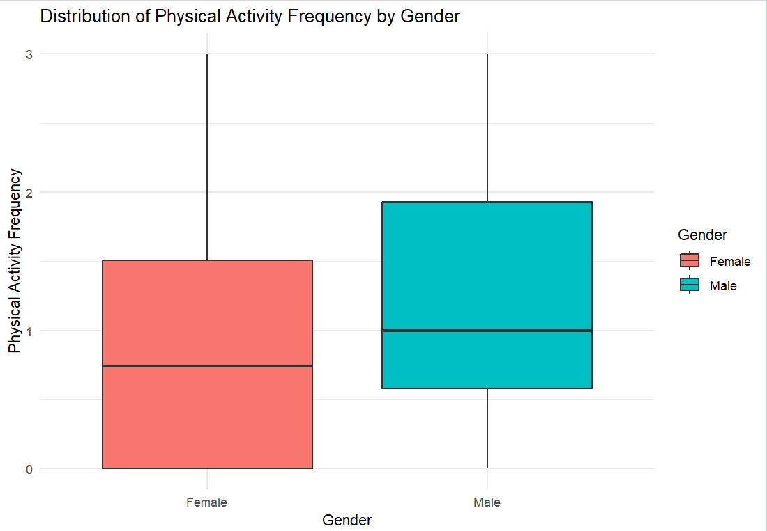
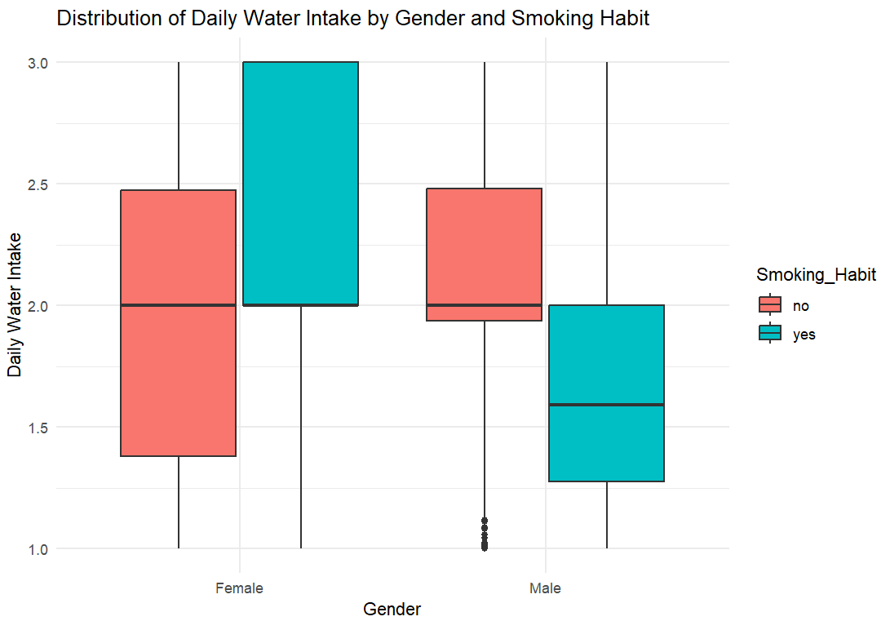
Physical Activity:
Females are less likely to do physical activity than males.
Water Intake and Smoking:
Males who smoke drink less water than males who don't smoke.
For females, it's the opposite: females who smoke drink more water than females who don't smoke.

Slide 22
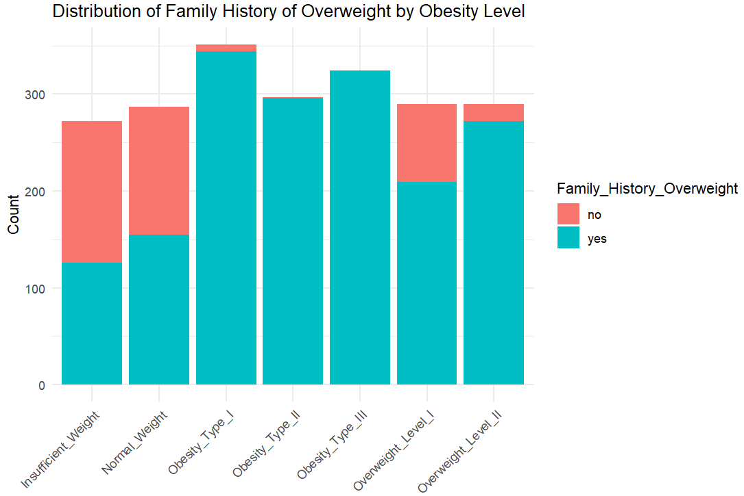
Family History and Obesity:
People who have a family history of overweight are more likely to suffer from obesity.
Most of the people with Obesity Type I, II, and III have a family history of overweight.

Slide 23
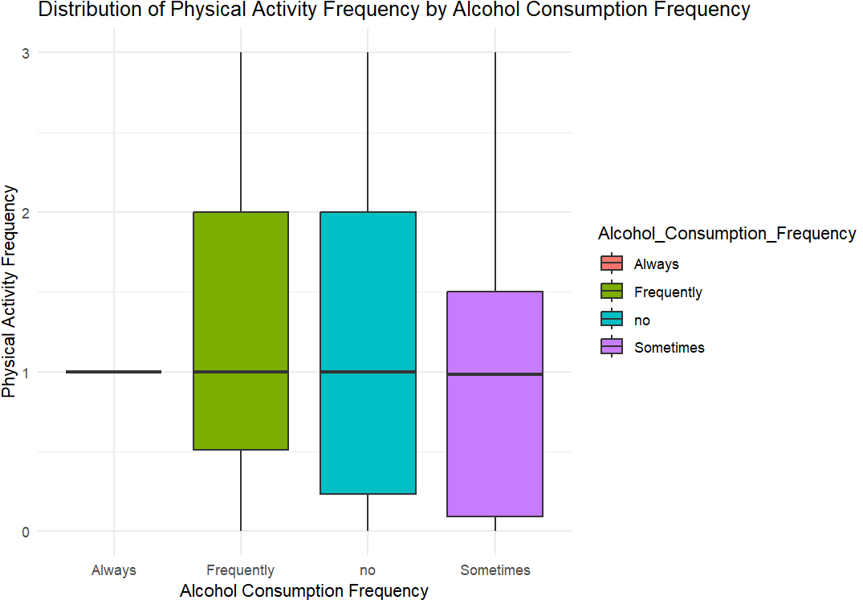
Alcohol Consumption and Physical Activity:
People who always consume alcohol do not engage in any physical activity.
People who drink alcohol sometimes do some physical activity, but the frequency is low.
People who do not drink alcohol are the most likely to engage in physical activity.

Slide 24
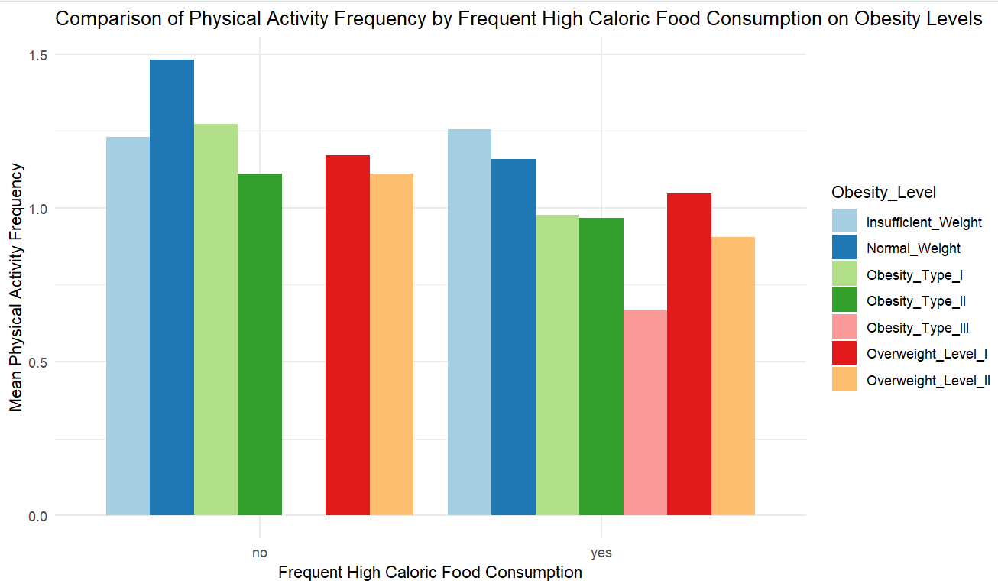
Normal Weight Category:
People in the normal weight category do not consume high-calorie diets and engage in more physical activity.
Obesity Type III:
All people with Obesity Type III consume a lot of high-calorie diets.
Insufficient Weight:
People with insufficient weight are consuming high-calorie diets and doing more physical activity.
Overall Obesity:
Overall, people with obesity are consuming high-calorie diets and doing less physical activity.

Slide 25
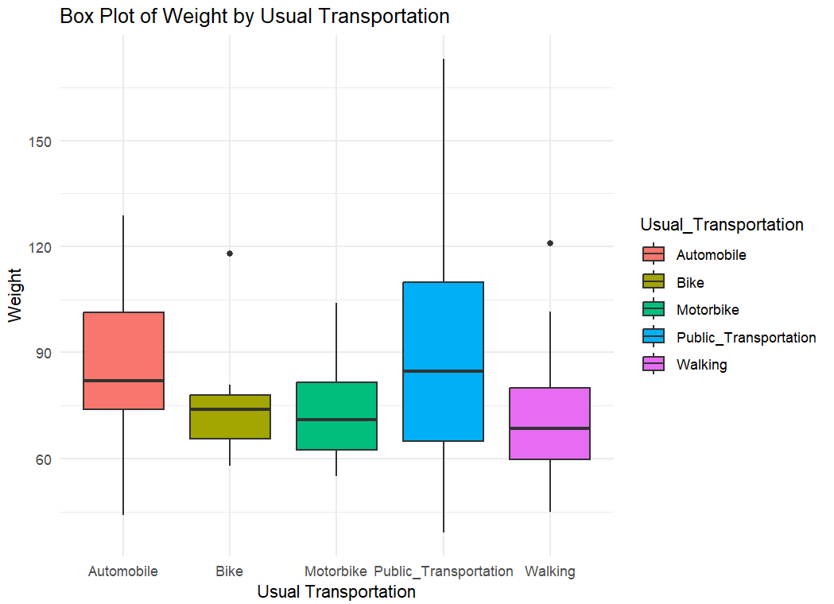
People who use a vehicle or public transportation have more weight compared to those who walk for transportation.
Walking for transportation is associated with lower weight compared to using a vehicle or public transportation.

Slide 26
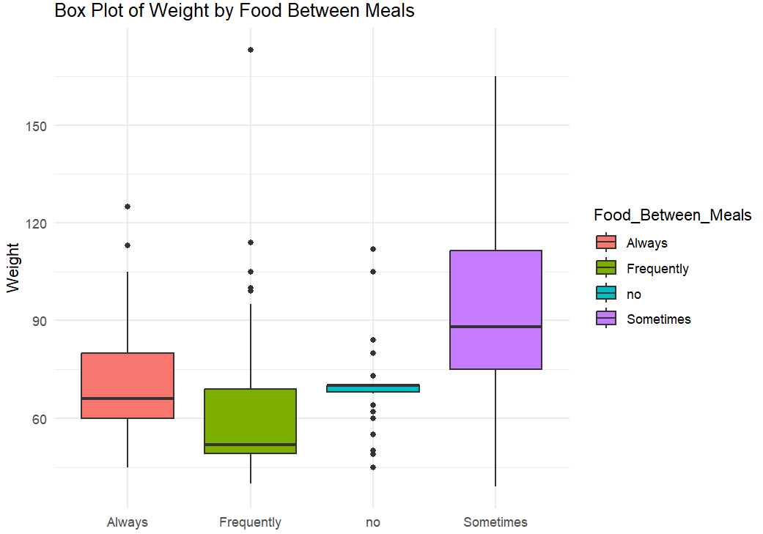
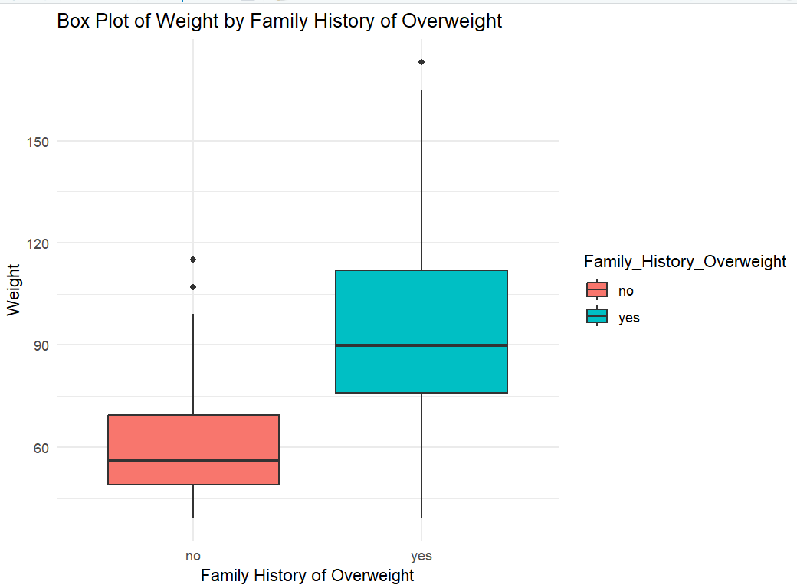
People who consume food between meals have more weight.
People who do not eat anything between meals are not as heavy.
People with a family history of overweight are more likely to have obesity.

Slide 27
Main Causes of Obesity:
High-Calorie Diets: People who consume high-calorie diets are more likely to be obese.
Lack of Physical Activity: Lack of regular exercise is linked to higher obesity levels.
Family History: Individuals with a family history of overweight are more prone to obesity.
Alcohol Consumption: Regular alcohol consumption is associated with higher obesity levels.
Transportation Choices: Using vehicles or public transportation is linked to higher weight.
Eating Habits: Consuming food between meals leads to higher weight.

Slide 28
Key Takeaways:
Maintaining a balanced diet and regular physical activity are crucial in preventing obesity.
Family history plays a significant role in an individual's likelihood of being obese.
Lifestyle choices, including transportation and eating habits, have a direct impact on weight.
Reducing high-calorie food intake and increasing physical activity can help manage and prevent obesity.

Slide 29
Thank You.

